Slide 1
Narratives in
The Early History of F#
Don Syme, Researcher and Community Contributor, Microsoft

Slide 2
A meta-talk about a meta-language
Not a recap of the paper
From 1970s to 2015
From Milner, Newey, Morris to Microsoft and Open Source

Slide 3
History is always written selectively
I’ll be explicit about the narratives I’ve chosen

Slide 4
Narrative #1
A personal journey

Slide 5
Narrative #2
A community’s journey
(and origin mythology)

Slide 6
Narrative #3
Things don’t just happen. Things happen to people, who act, react and change in very human ways
creation, rejection, denial, stubbornness, cooperation, subversion, opportunism, …

Slide 7
Narrative #4
What happens when computing traditions with strong belief systems collide, both in industry and academia?

Slide 8
Narrative #5
The dynamic interplay between academic research and industry concerns, between programming and programmability

Slide 9

Narrative #6
The golden thread – what holds true in programming language design, what stands the test of time?

Slide 10
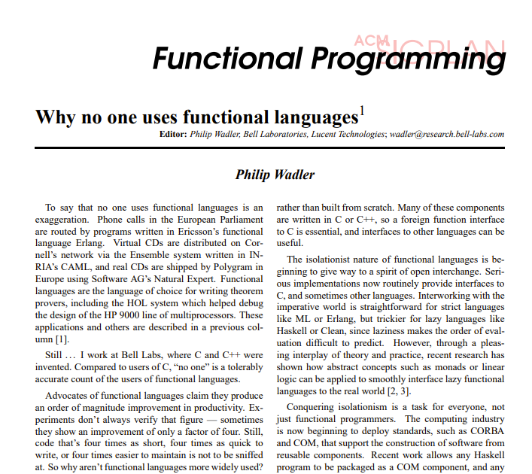
The World as It Was
(~1997)

Slide 11
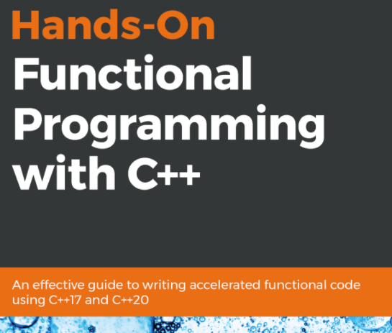
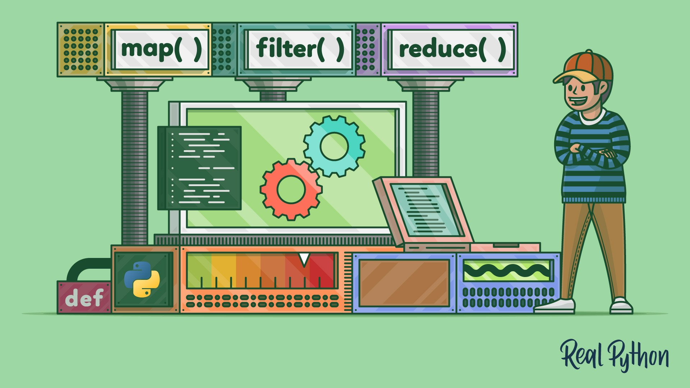
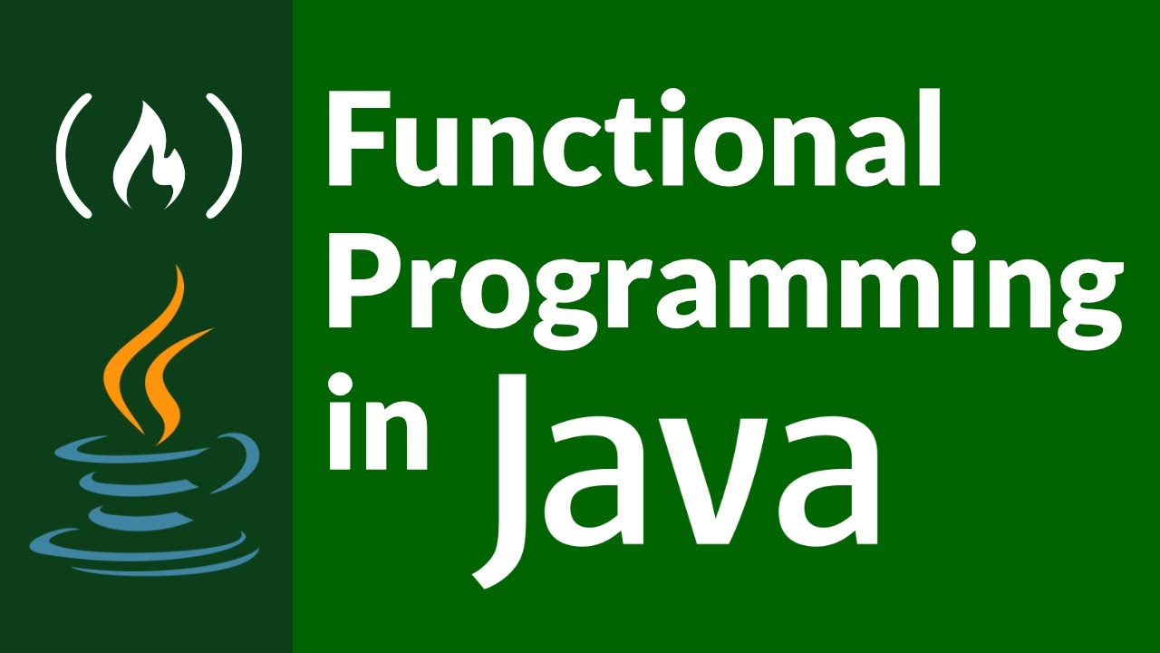
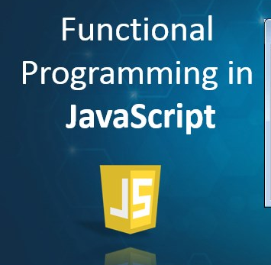
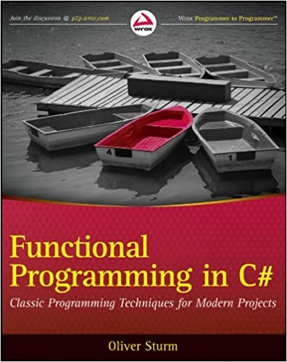
The World Today
Practical Strongly Typed Functional Programming Techniques are Used Everywhere

Slide 12

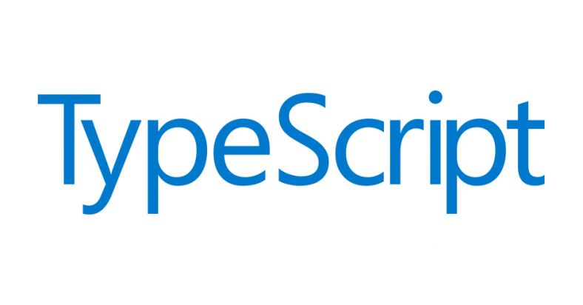


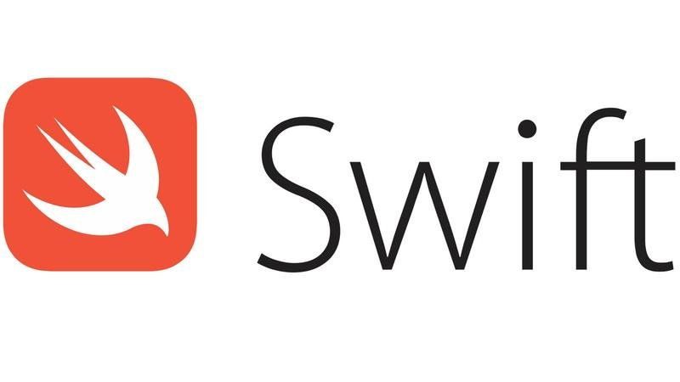
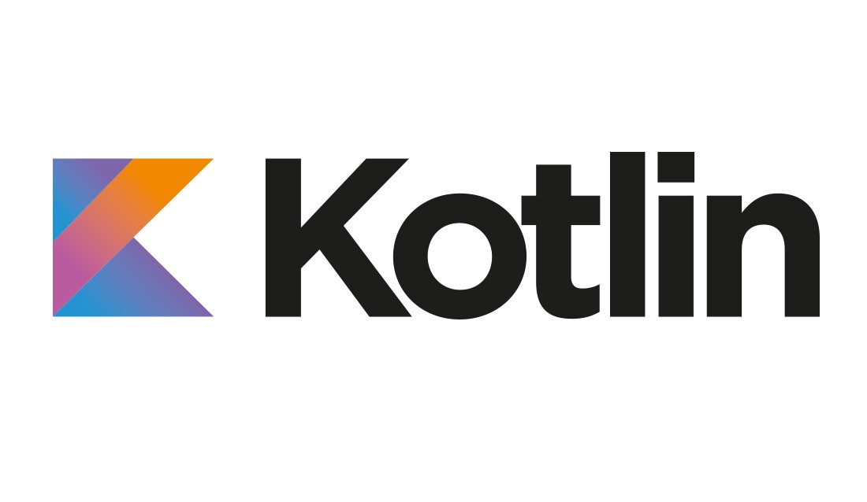
The World Today
Practical Strongly Typed Functional Programming Languages are Usable Everywhere

Slide 13

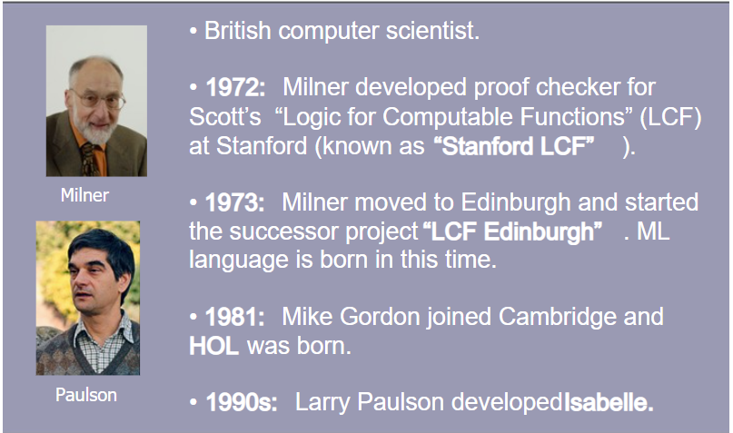
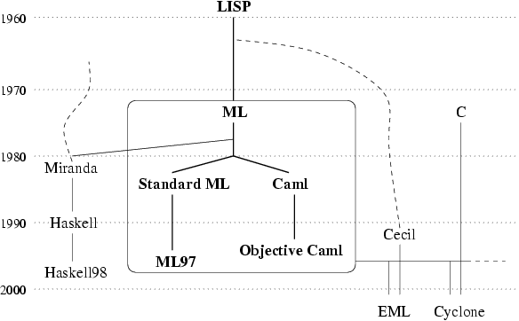

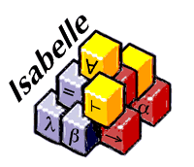
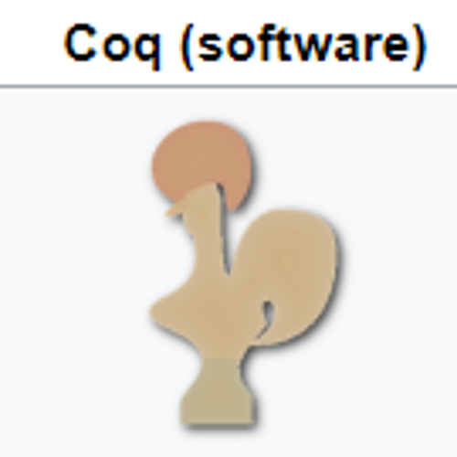
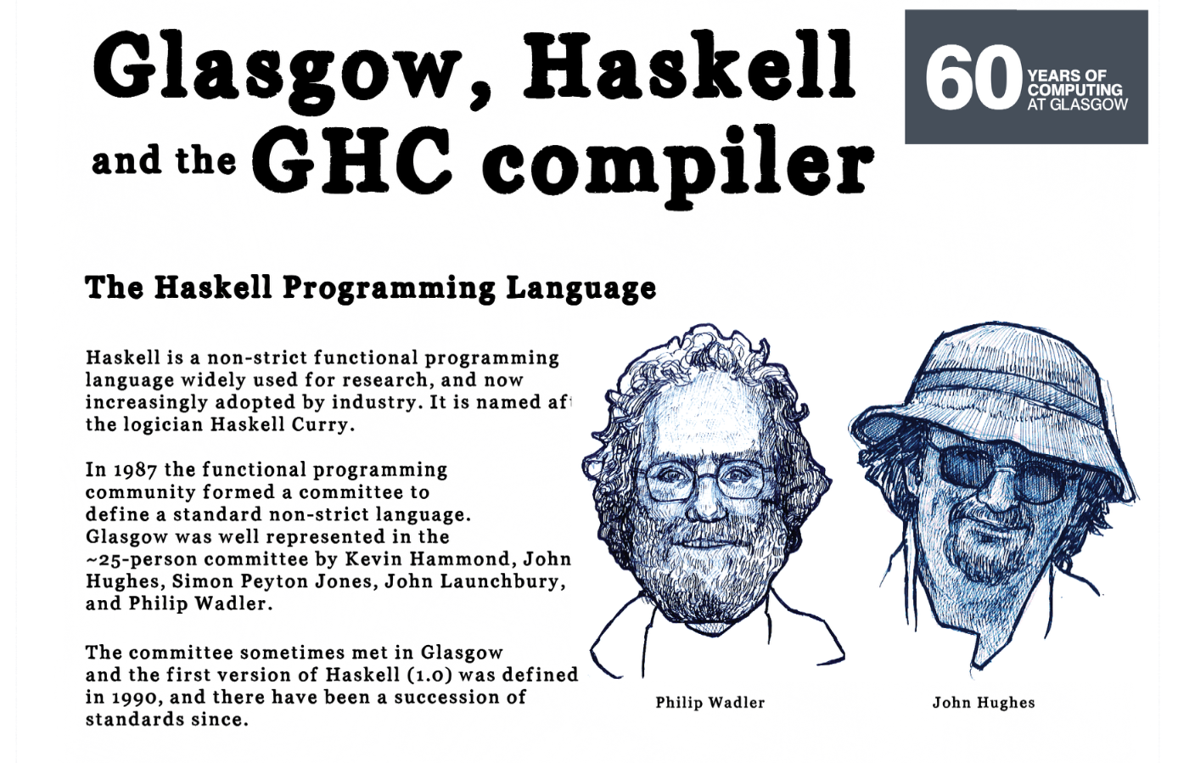
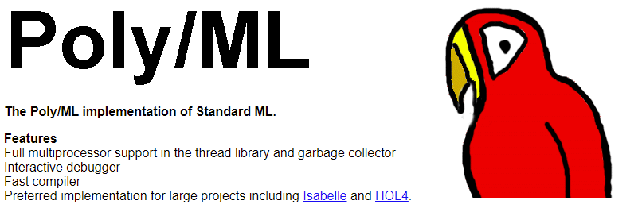
Rollback to 80s-90s
Strongly typed FP was small but active tribe.
Rooted in theorem proving, theory, Standard ML, Haskell, OCaml, experiments

Slide 14


The Object-Oriented Tidal Wave, 1986-1998
A story in itself, colossal impact
On Platform Companies (Obj-C, C++, Java)
On Microsoft (C++, Java)
On CS Academia (Java)
On Every Programming Language

Slide 15
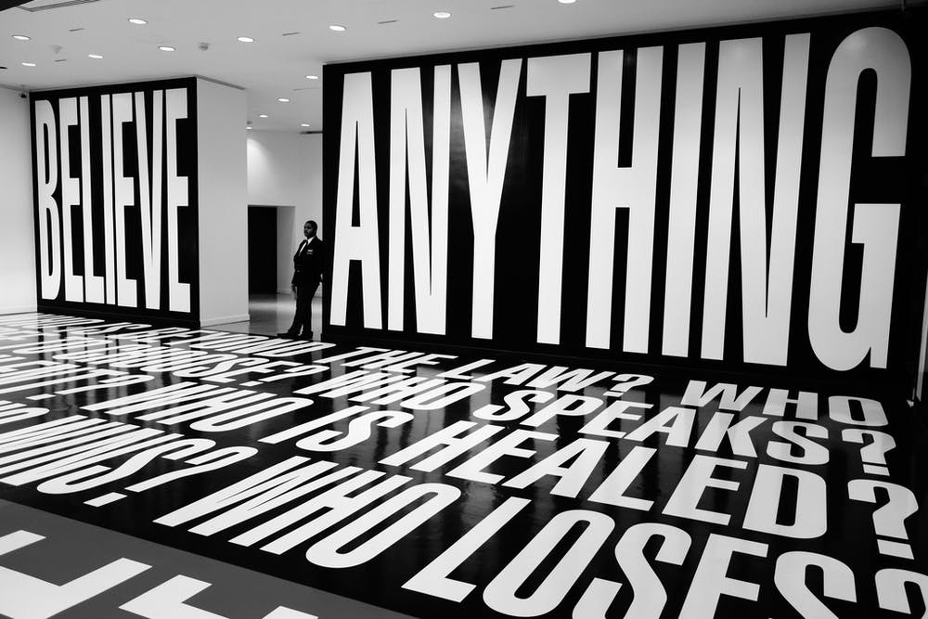
Response 1
Find something else to believe in

Slide 16
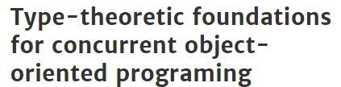
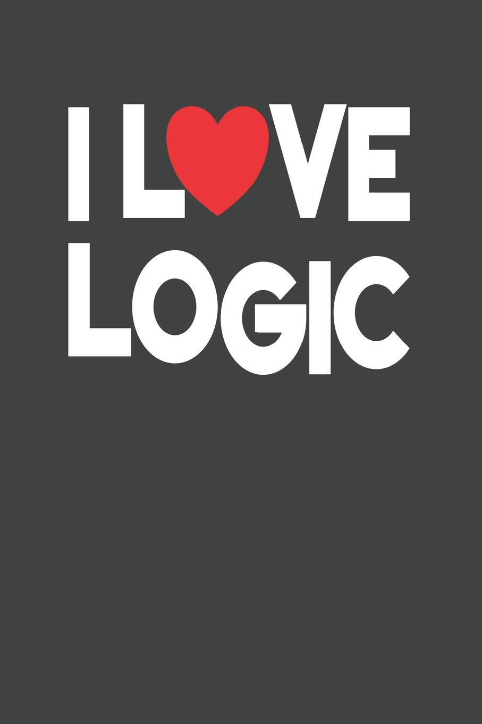



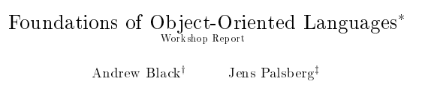
Response 2
Retreat to the fort! Focus on Foundations! Focus on Pure Functional!

Slide 17
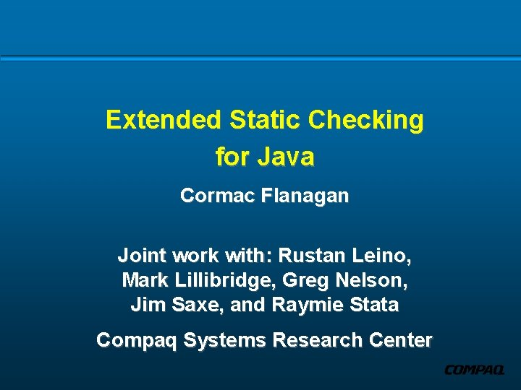

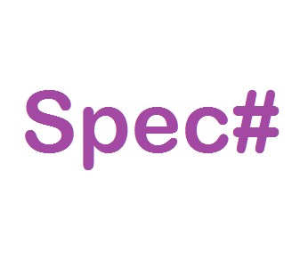
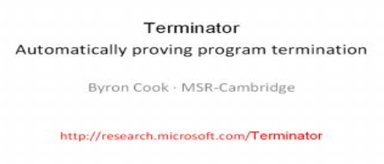
Response 3
Verify the stuff using functional/theory tools!

Slide 18


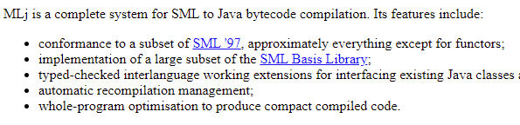
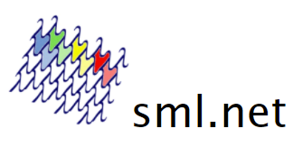
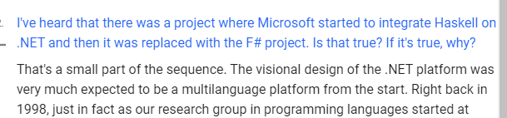
Response 4
Oh yeah! Get my language running on those object VMs!

Slide 19
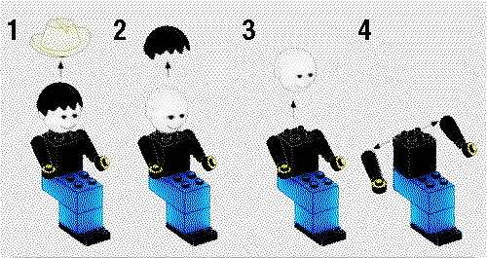
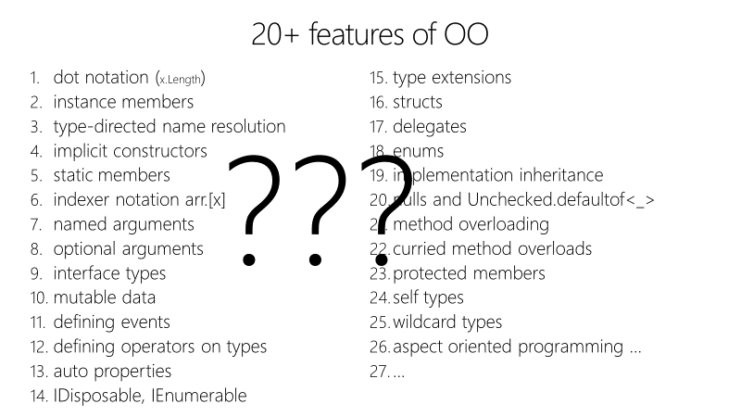
Response 5
Rationally deconstruct Functional and Object Programming

Slide 20


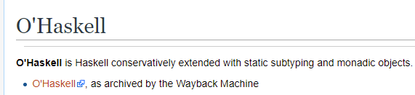
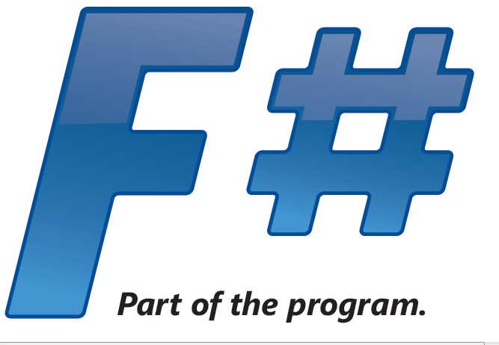
Response 6a
Seek a synthesis!
Make Functional Languages more Object-Oriented!

Slide 21
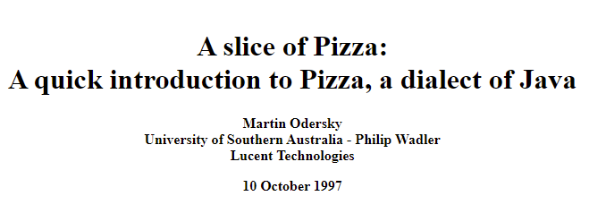
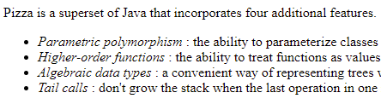


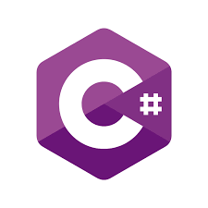

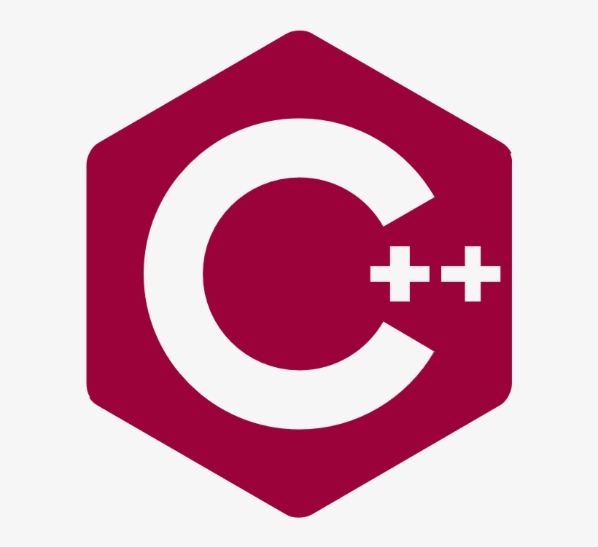
Response 6b
Seek a synthesis!
Make Object-Oriented Languages more Functional!
+ many other more recent examples

Slide 22
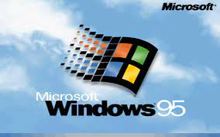
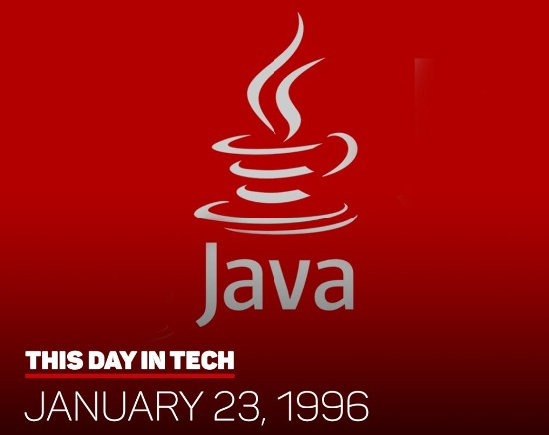
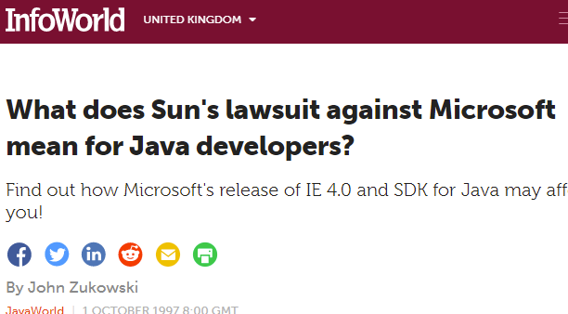


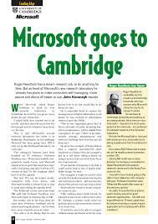

Meanwhile…. Over at Microsoft….

Slide 23
The worlds of Robin Milner and Bill Gates collide!
All the tribes of computer science descend on Microsoft and Microsoft Research!
Much early work centred on .NET

Slide 24
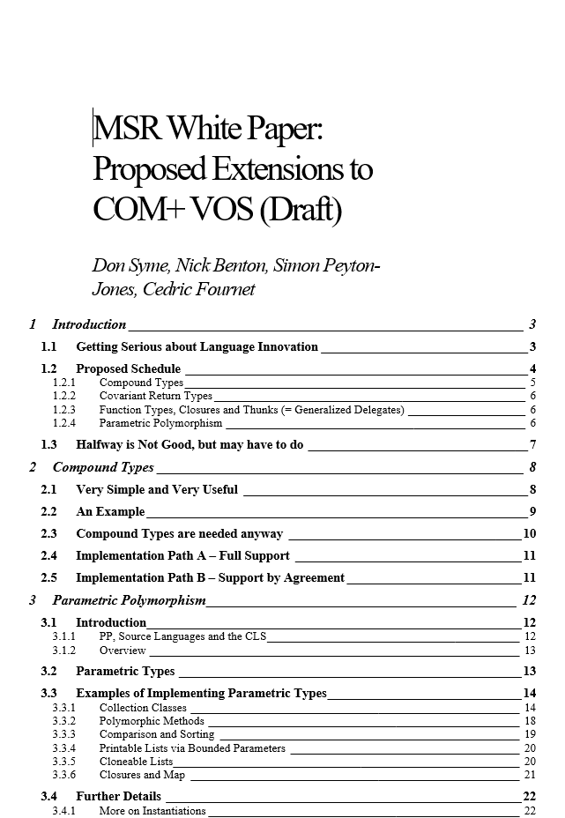

.NET Generics (1998-2004)
Breaking through the nominal, class-based Object-Oriented wall
Built on GJ, Pizza by Wadler/Odersky et al
“Puts .NET 20 years ahead”

Slide 25
By 2002 .NET Generics was safely landed
However, C# 2.0 was still, from the strongly-typed FP perspective, verbose, unusable, untrustworthy
Sample after sample showed 3x-5x code size difference for like-for-like, full of null checking etc.

Slide 26
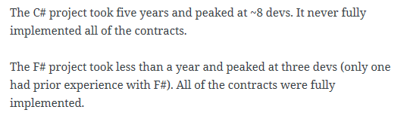
A later example
350,000
lines of C# OO
by offshore team
30,000
lines of robust F#, with
parallel +more features
An application to evaluate the revenue due from Balancing Services contracts in the UK energy industry
http://simontcousins.azurewebsites.net/does-the-language-you-use-make-a-difference-revisited/

Slide 27
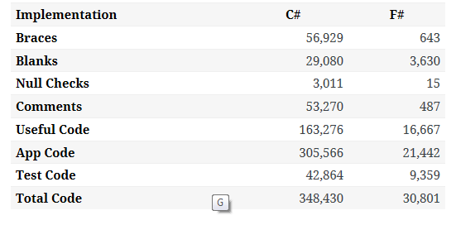

Slide 28
F# 1.0 was born from an obsessive compulsion - “we must do this or else what else are we here for?”
A desire to ensure strongly-typed FP was a real option in the 2000s

Slide 29

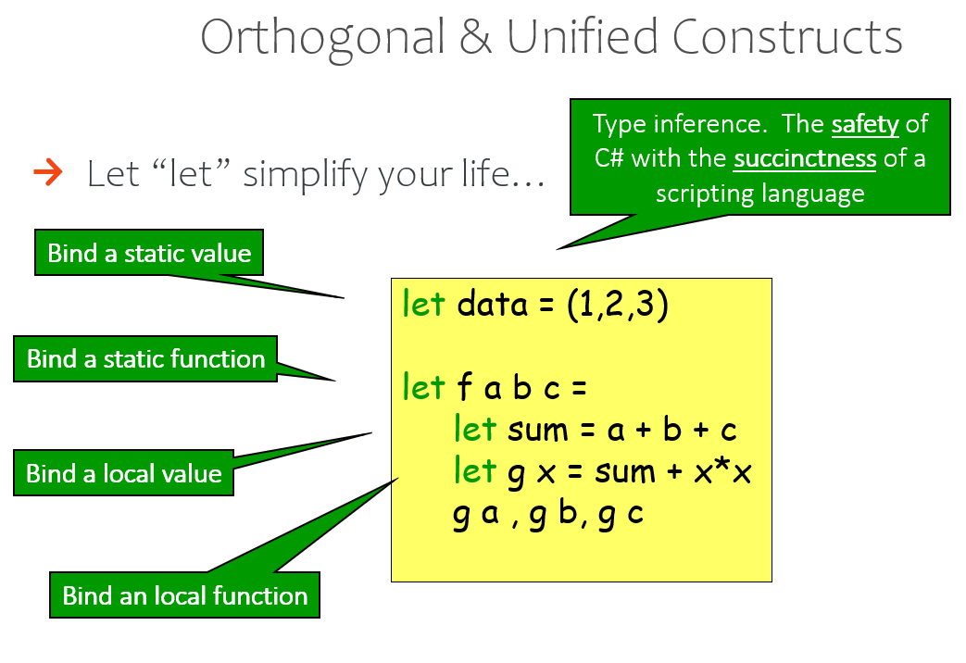
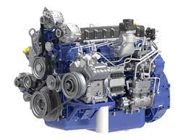
OCaml
.NET Runtime
(This is a truck engine)

Slide 30
The F# approach
Start with Caml Core
Stay true to core FP principles
Interoperate
Reuse industrial VM+ecosystem
Deconstruct OO, FP, find synthesis
Include IDE tooling, REPL
Deliver and apply in industry
Long-term home at Microsoft (Research)
Focused iterative improvements

Slide 31
Breaking the Rules of the Strongly Typed Functional Tribe
Beliefs held, Beliefs lost, Beliefs gained

Slide 32
Type definitions, algebraic modelling and objects
Soundness and
Formalization
Parameterization
Expression-oriented programming
Runtime, ecosystem, interop
Types and Type Inference
Computational
modalities
(comprehensions, async, monads, monoids…)

Slide 33
Nominal objects (classes, interfaces)
Structural objects
Languages must have a formal specification!
Functors (parameterized large components)
Type definitions
Functional objects
Soundness
Soundness is supreme
Functional abstraction and parameterization
Parameterization
Immutable by default, algebraic data
Initialization soundness, no nulls
Expression-oriented programming
Types for modelling, perf, correctness, interop
“F# types are .NET types, .NET types are F# types”
Hindley-Milner for typed succinctness
List comprehensions
Types and Type Inference
Interop
Hindley-Milner modified for objects+more
Computational
modalities
(comprehensions, async, monads, monoids…)
Type Providers
Monadic notation
Fast generic unboxed arith + inline
Type-classes and type-level computation
Rich, compositional computation notation
Types for logic and proof

Slide 34
2008-2014 – “F# Parachutes Into the Dark Heart of the Industry”
An Introduction to F# - Luca Bolognese 2008
F# Eye for the C# Guy – Phil Trelford
F# Eye for the C# Guy – LeonBambrick

Slide 35
F# 1.0 – 5.0
Dialectics in Action

Slide 36
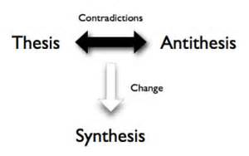

Slide 37
Academia
Industry/
Reality
Microsoft Research

Slide 38
Functional
Interop
2004: F# 1.0 on .NET
2016: Fable on Javascript

Slide 39
Strong
Typing
Dynamic, Explorative, REPL, Data
2005: F# Interactive REPL on .NET

Slide 40
Functional
Objects
2006: F# Object Programming
(modified Hindley-Milner, type-directed name resolution,
nominal, subtype-friendly, delegation-oriented, expression-friendly)

Slide 41
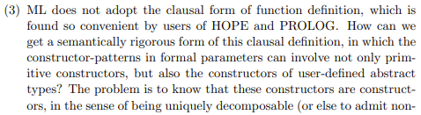
Pattern Matching
Abstraction
https://www.pure.ed.ac.uk/ws/portalfiles/portal/17084823/Milner_R_1982_How_ML_Evolved.pdf
2006: F# Active Patterns
(Views made practical and simple)

Slide 42
Plain code
Computational modalities
(co-routines, tasks, multi-threading, monads, monoids, comprehensions, queries, DSLs)
2007: F# Async and Computation Expressions

Slide 43
Typed Code
A Vast World of Connected Data
2010: F# Type Providers
(compile-time meta-programming to compute type
spaces based on external information sources)

Slide 44
Enterprise
Openness
2010-15: C#, F#, Microsoft embrace openness and cross-platform normality

Slide 45
Computational modalities in C#, F# (computation expressions)
C# Iterator methods
C# Query expressions
modality { code }
C# Collection initialization
C# Async methods
2007 – monads, monoids, async, comprehensions
2012 – queries, extended comprehensions
2020 – applicatives
C# Async iterator methods

Slide 46
Computational modalities in C#, F# (computation expressions)
C# Iterator methods
seq { code + yield }
C# Query expressions
query { code + yield + custom }
C# Collection initialization
list { code + yield }
C# Async methods
async { code + bind }
C# Async iterator methods
asyncSeq { code + bind + yield }
coroutine { code + yield() }

Slide 47

F# : Objects + Functional = ️
type Vector2D(dx:double, dy:double) =
let d2 = dx*dx+dy*dy
member _.DX = dx
member _.DY = dy
member _.Length = sqrt d2
member _.Scale(k) = Vector2D (dx*k, dy*k)
Inputs to object
construction
Object internals
Exported properties
Exported method

Slide 48
Functional
 | Expression-oriented | No null | Multiple Args = Tuples | Closure and Capture | First-class Values | Currying | HM Type Inference
void (unit) | ✓ | ✓ | ✓ | ✓ | ✓ | ✓ | ✓
Object Types | ✓ | ✓ | ✓ | ✓ | ✓ | ✓ | ✓
Subtyping | ✓ | ✓ | ✓ | ✓ | ✓ | ✓ | ✓
Dot-notation | ✓ | ✓ | ✓ | ✓ | ✓ | ✓ | ¾
Inheritance | ✓ | ✓ | ✓ | ✓ | ✓ | ✓ | ¾
Method Overloding | ✓ | ✓ | ✓ | ✓ | ¾ | ✗ | ¾
Objects
Relatively Graceful Degradation
(some type annotations needed)
Relatively Graceful Degradation
(some type annotations needed)
Some combinations outlawed for sanity

Slide 49


F# Today
So much I could say about this
F# has a strong position as the “functional language for .NET”
  Delivery in the .NET SDK, F# exists wherever C# exists
  Also Fable, a Javascript compiler for F#
Strong stories for web-client, mobile, server-side, cloud
Strong methodologies for practical, applied functional programming in practice

Slide 50
The influence of F#?
Culturally, F# core team existed “right next door” to C# core team, leading to many direct influences both ways

Slide 51
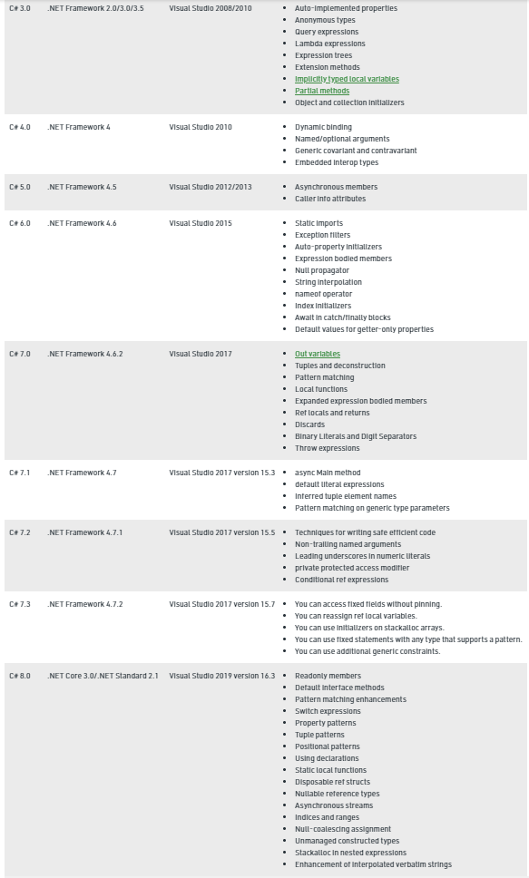
+ C# 9.0 records, top-level statements

Slide 52
Other Influences of F#...
C# (via Hejlsberg, Meijer, Hoban, Parsons, Torgersen + others),
Scala (via Odersky + others – extractors + more)
TypeScript, Swift, Elm, Kotlin (F# was a reference point)
Python (via C# - async)
Java, C++ … (via C# - async)

Slide 53
Concluding Remarks

Slide 54
The golden thread of strongly-typed FP is the simplicity of the core experience, e.g.
  let f x = (x, x)
  type term = T of string * term list
  …
Milner, Newey, Morris saw this in 1970, I personally experienced it in 1990, and it’s stayed true.

Slide 55
Concluding Notes
The programming world has corrected the OO dominance of the late 90s
  Generics, lambdas, parameterization, immutability, algebraic types, various computational modalities, type inference have now rightly occupied their place as practical core techniques in nearly all programming languages
F# has been a part of this story since 2003
  Part of the reaction of the functional tribe to the OO tidal wave
  Stayed true to its core design goals
  Many practical additions to the expression-oriented, statically typed paradigm
  A strong user base and a secure future
One way or another, the golden thread will appeal far into the future.

Slide 56
Backup slides

Slide 57
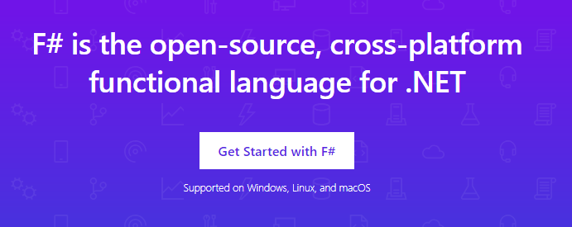
www.microsoft.com/net/

Slide 58
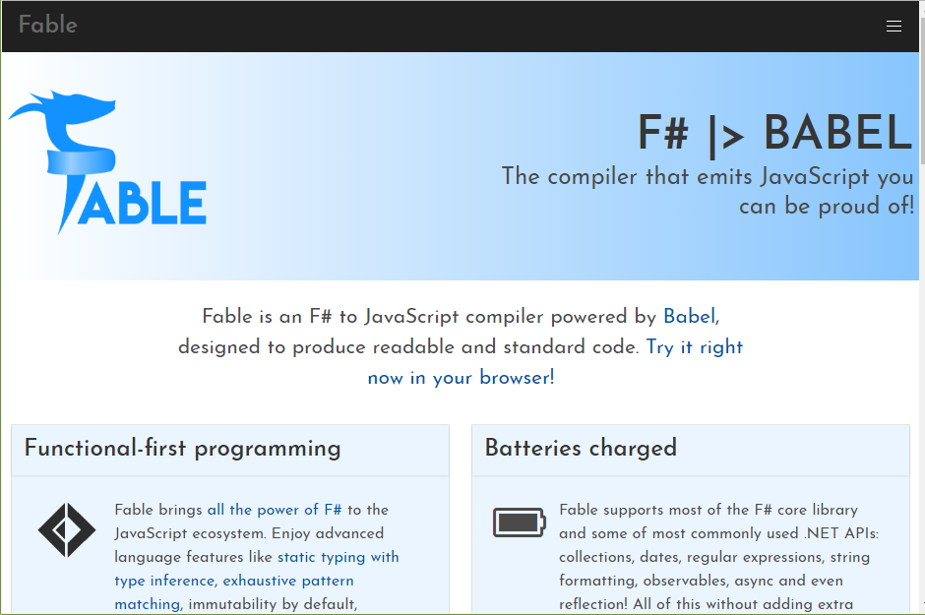

Slide 59
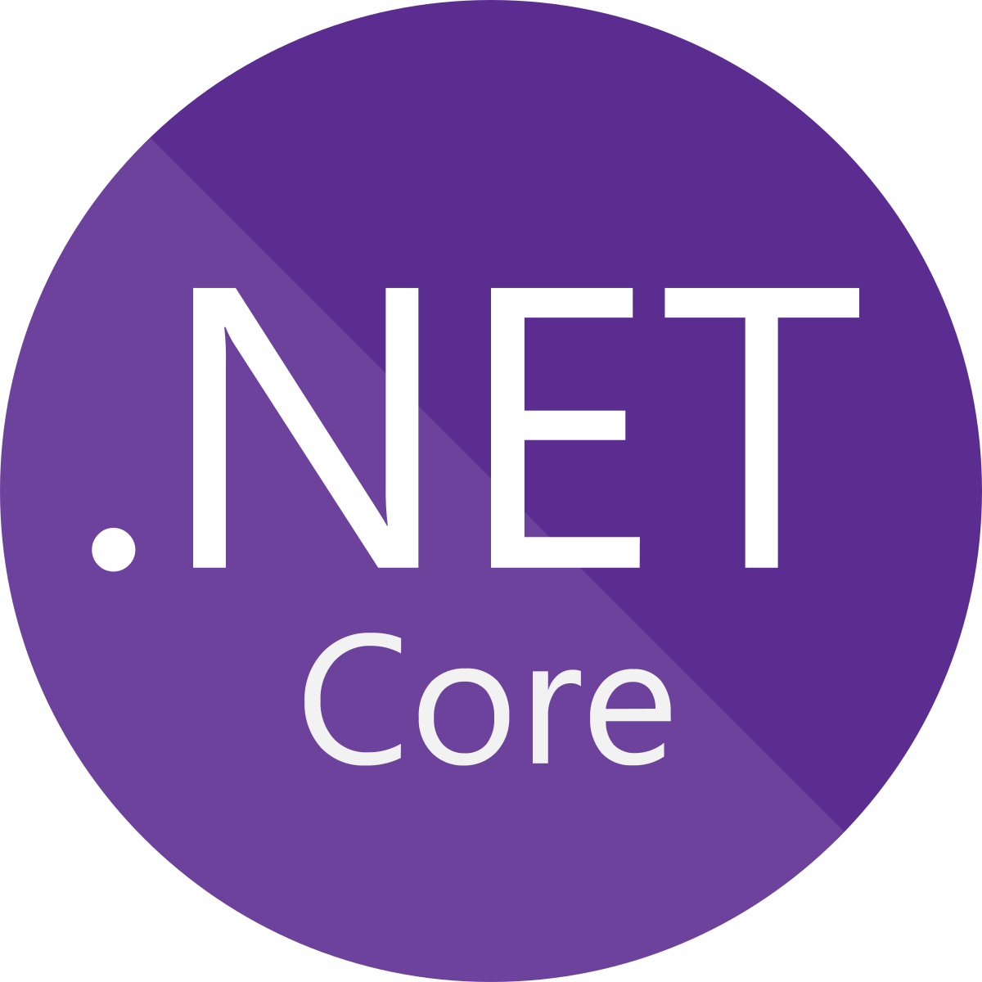





F# get started dotnet new -lang F# dotnet build

Slide 60
F# get started dotnet new -lang F# dotnet build
F# tools are part of the .NET SDK, available everywhere

Slide 61

F# for the backend dotnet new -i "giraffe-template::*" dotnet giraffe
A functional ASP.NET Core micro web framework for building rich web applications.
github.com/giraffe-fsharp/Giraffe

Slide 62
F# for the backend dotnet new -i "giraffe-template::*" dotnet giraffe
A functional ASP.NET Core micro web framework for building rich web applications.
High perf, functional server-side programming
github.com/giraffe-fsharp/Giraffe

Slide 63
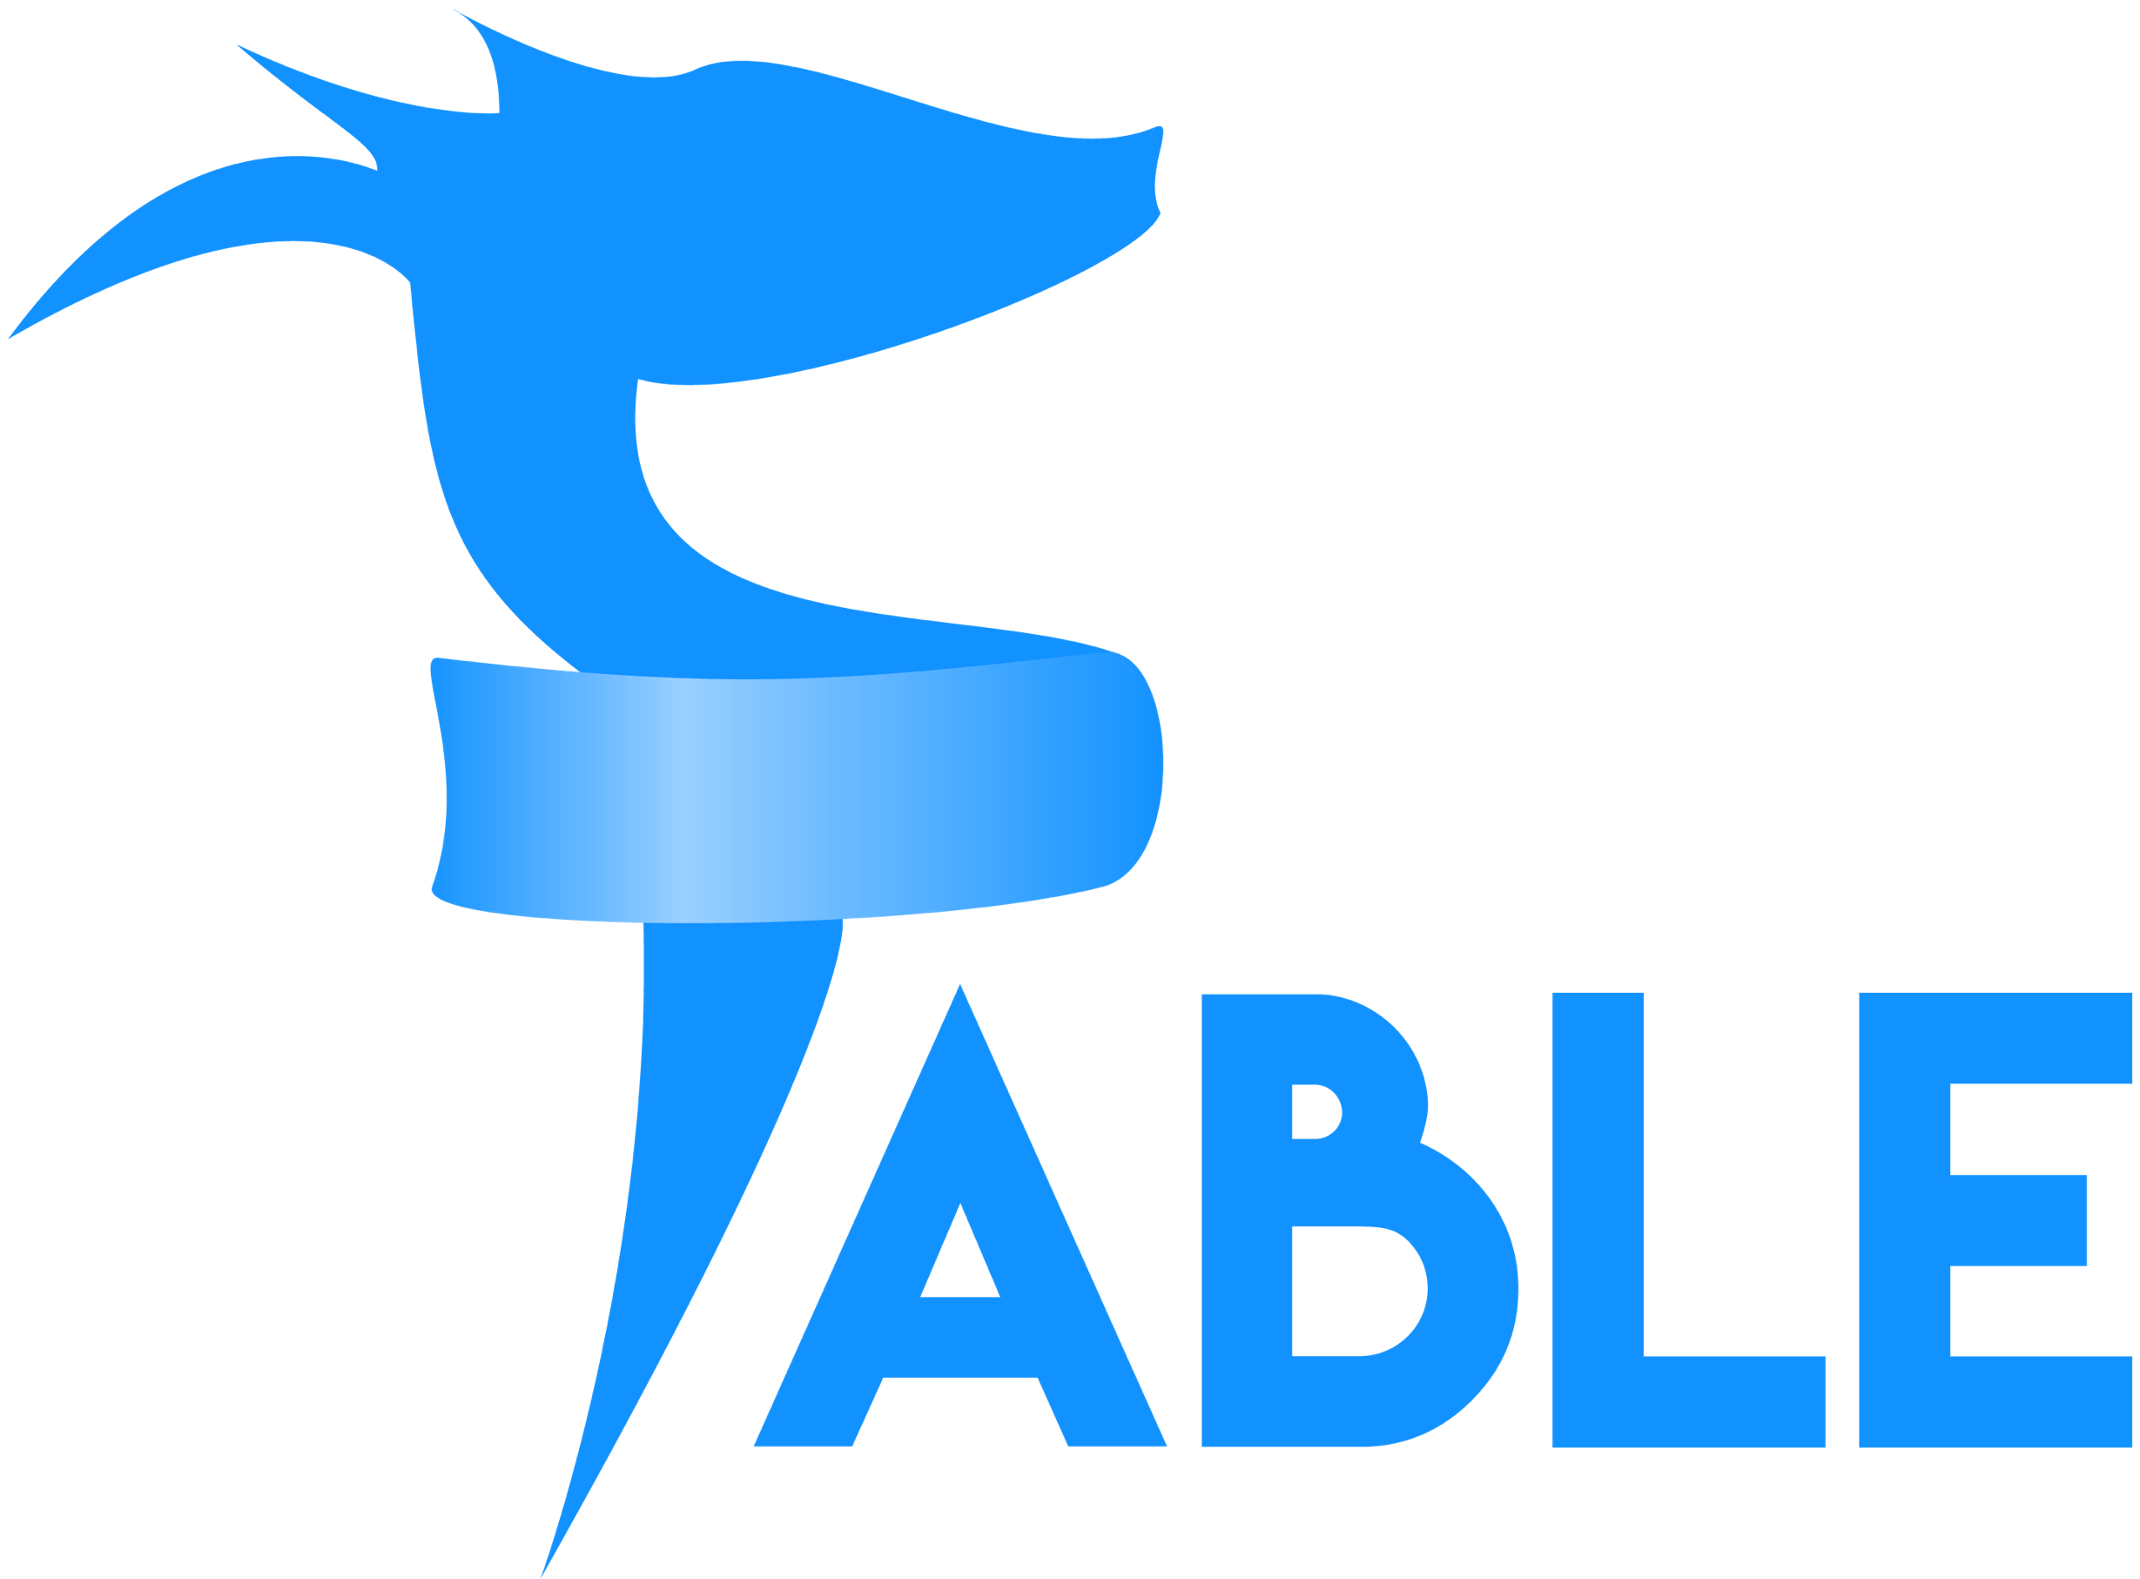
F# for the frontend (JS) dotnet new -i "Fable.Template::*" dotnet new fable npm install npm start

Slide 64
F# for the frontend (JS) dotnet new -i "Fable.Template::*" dotnet new fable npm install npm start
You can use F# as a Javascript language

Slide 65

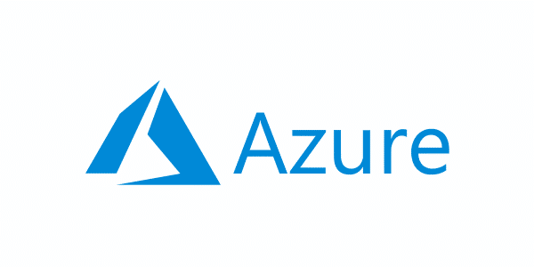
F# for the full stack dotnet new -i SAFE.Template dotnet new SAFE dotnet tool restore dotnet fake run
=
+

Slide 66


A $3B Unicorn, Built on F#

Slide 67
F# 5.0! (2021)
✔ #r nuget packages in scripts “#r "nuget: Newtonsoft.Json"
✔ Jupyter and .NET Interactive notebooks!
✔ string interpolation
✔ nameof
✔ applicatives syntax in computation expressions
✔ improved .NET interop
✔ improved Map/Set performance + more
https://github.com/fsharp/fslang-design/tree/master/FSharp-5.0

Slide 68
Enter F# Type Providers….
“Just like a library”
“A design-time component that computes a space of types and methods on-demand…”
“An adaptor between data/services and the .NET type system…”
“On-demand, scalable compile-time provision of type/module definitions…”

Slide 69
https://fsprojects.github.io/FSharp.Data/images/json.gif

